Slide 1
Unit III: Control Unit Organization
Hardwired Control Unit and Timing Signals,
Microprogrammed control unit:
control memory,
Address sequencing,
Microprogram Example, Designing of microprogrammed control unit.
Comparison of hardwired and microprogrammed control units,
RISC and CISC Processors

Slide 2

Control Unit
Present in CPU
Coordinate between CPU , Main memory, I/O devices
Types
Hardwired Control unit
Made hardware components like logic gates, flip flops, decoders, registers etc.
Microprogrammed Control Unit
Designed using microprogram, controlled memory

Slide 3

Hardwired Control unit
Uses fixed logic circuits to generate control signals
Faster than microprogrammed control units
Difficult to modify or update once designed
Typically found in RISC processors
Efficient for simple, high-speed operations

Slide 4
Hardwired Control unit
Advantages:
Faster execution due to dedicated circuits
Less memory usage compared to microprogrammed units
Immediate response without delay from memory access
Disadvantages:
Difficult to modify or upgrade
Complex logic design for modern instruction sets
Less flexible compared to microprogrammed control

Slide 5
Hardwired Control unit
Working Principle
Input: Opcode from instruction register
Control logic generates necessary control signals
Uses combinational circuits (AND, OR, NOT gates)
Generates precise signals for ALU, registers, memory, and buses
Works in synchronization with system clock

Slide 6
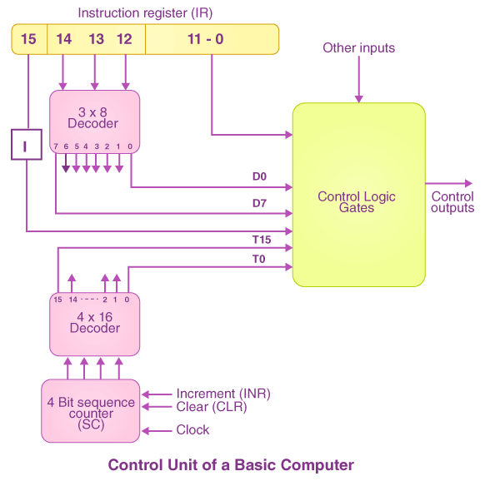
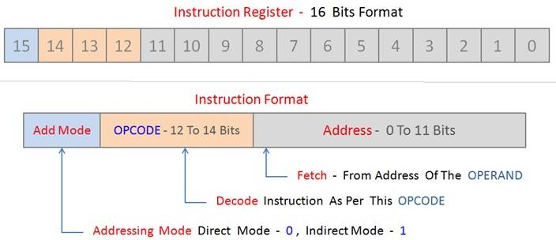
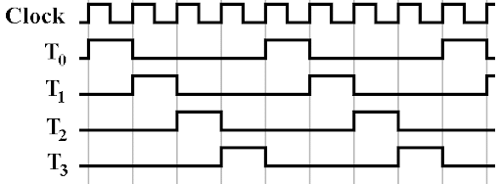
Hardwired Control unit
Decoder input 3 bit
Decoder output 8 bit
E.g. 000,001,010, ..

Slide 7
Hardwired Control unit
Timing Signals
Signals that synchronize operations within a CPU
Generated by system clock or control unit
Ensure correct sequence of instruction execution
Used to control data transfer between registers and memory
Essential for synchronous digital circuits
Working Methods
System clock generates periodic pulses
Control unit decodes instructions & generates timing signals
Each instruction phase (fetch, decode, execute) gets a timing signal
Ensures proper data flow across CPU components
Prevents race conditions and timing mismatches

Slide 8
Hardwired Control unit
Example: Executing ADD R1, R2, R3
T1: Fetch instruction from memory
T2: Decode instruction in control unit
T3: Read operands R2, R3 from register file
T4: Perform addition in ALU
T5: Store result in R1 Each step is activated by a specific timing signal

Slide 9

Microprogrammed Control Unit
Uses a control memory to store microinstructions
Executes microinstructions sequentially
Flexible and easier to modify than hardwired control
Common in CISC architectures
Slower than hardwired control due to memory access

Slide 10
Control Memory
Stores microinstructions for control signals
ROM or writable memory used for microprogram storage
Fetch-decode-execute cycle guided by microinstructions
Each microinstruction specifies control signals
Example: Fetch instruction from memory, decode opcode, execute

Slide 11
Address Sequencing
Determines next microinstruction to execute
Types of sequencing:
Incrementing control memory address
Branching based on condition flags
Indirect address from control memory
Optimizes execution path in control unit
Example: Conditional branching in microprogram execution

Slide 12
Microprogram Example
Example: Execution of ADD R1, R2
Step 1: Fetch instruction from memory
MAR ← PC, Read Memory
PC ← PC + 1, IR ← MDR
Step 2: Decode instruction Identify opcode and source/destination registers
Step 3: Execute ADD operation
R1 ← R1 + R2

Slide 13
Comparison
Hardwired Control Unit:
Uses fixed logic circuits for control signals
Faster execution due to direct hardware implementation
Difficult to modify or update
Common in high-performance processors
Microprogrammed Control Unit:
Uses a control memory storing microinstructions
Easier to modify and implement complex instructions
Slower due to memory access overhead
Common in CISC architectures

Slide 14
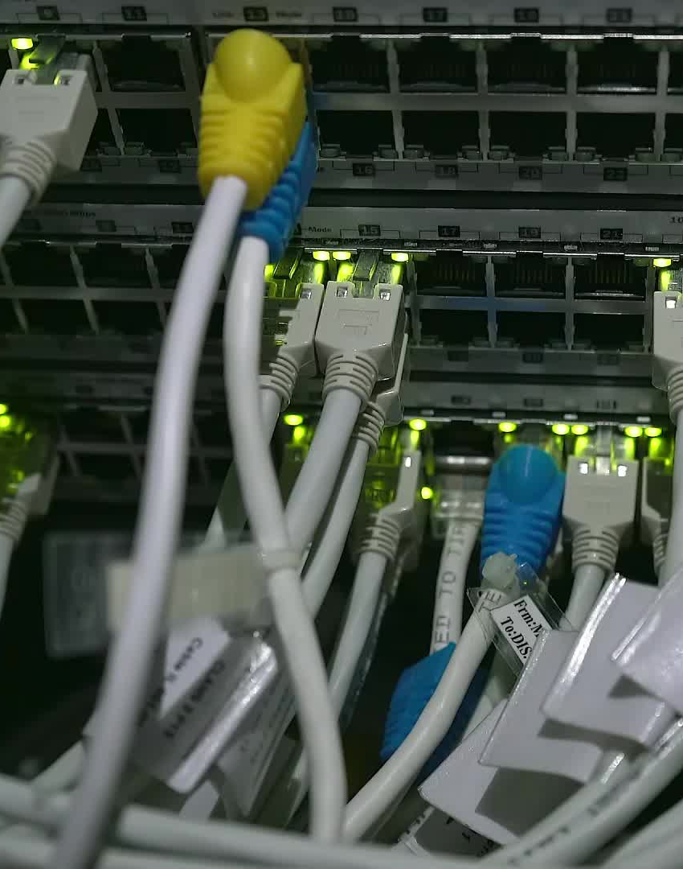
Essential Instructions for the Processor
Load (LD) / Store (ST) - Transfer data between memory and registers
Add (ADD) / Subtract (SUB) - Perform basic arithmetic operations
AND, OR, XOR, NOT - Logical operations for decision making
Jump (JMP) / Conditional Jump (JMPZ, JMPL) - Control flow management
Shift Left (SHL) / Shift Right (SHR) - Bitwise operations for efficiency

Slide 15
Sample Assembly Code Execution
Example: Computing C = A + B and storing in memory
LD R1, A ; Load A into register R1
LD R2, B ; Load B into register R2
ADD R3, R1, R2 ; R3 = R1 + R2
ST R3, C ; Store result in memory

Slide 16
MICROPROGRAMMED CONTROL Control Memory
Microprogram
- Program stored in memory that generates all the control signals required to execute the instruction set correctly
- Consists of microinstructions
- It is generally ROM.
Microinstruction
- Contains a control word and a sequencing word
Control Word - All the control information required for one clock cycle
Sequencing Word - Information needed to decide the next microinstruction address
- Vocabulary to write a microprogram
Control Memory(Control Storage: CS)
- Storage in the microprogrammed control unit to store the microprogram
Writeable Control Memory(Writeable Control Storage: WCS)
- CS whose contents can be modified
-> Allows the microprogram can be changed
-> Instruction set can be changed or modified

Slide 17
Dynamic Microprogramming
- Computer system whose control unit is implemented with
a microprogram in WCS
- Microprogram can be changed by a systems programmer or a user
Fig: Microprogrammed Control Organization
Sequencer (Microprogram Sequencer)
A Microprogram Control Unit that determines the Microinstruction Address to be executed in the next clock cycle
- In-line Sequencing
- Branch
- Conditional Branch
- Subroutine
- Loop
- Instruction OP-code mapping
CAR- Control Address Register
CDR- Control Data Register
External
input
Next Address
Control
Memory
(ROM)
Generator
(sequencer)
CAR
CDR
Control
word

Slide 18
ADDRESS SEQUENCING (Microprogram )
Instruction code
-microprogram contents micro instructions
-microinstruction contents micro-operations
Mapping
logic
Status
bits
Branch
MUX
Multiplexers
logic
select
Subroutine
register
(SBR)
Control address register
(CAR)
Incrementer
Control memory stores micro program
Control memory (ROM)
select a status
bit
Branch address
Microoperations
Sequencing Capabilities Required in a Control Storage
- Incrementing of the control address register
- Unconditional and conditional branches
- A mapping process from the bits of the machine instruction to an address for control memory
- A facility for subroutine call and return

Slide 19
ADDRESS SEQUENCING (Microprogram )
Process
Increment CAR by 1
Subroutine Register (Collection of instruction) : for repetitions of instruction like recursive functions
conditional and unconditional branch
Conditional: check the condition. Then load the address in CAR. Check the status bit then load accordingly
Unconditional: without checking the condition the corresponding register address will be loaded into CAR
Mapping Instruction: Mapping logic (Next slide)
Instruction code
Mapping
logic
Status
bits
Branch
MUX
Multiplexers
logic
select
Subroutine
register
(SBR)
Control address register
(CAR)
Incrementer
Control memory (ROM)
select a status
bit
Branch address
Microoperations

Slide 20
MAPPING OF INSTRUCTIONS
Direct Mapping
Address
OP-codes of Instructions
0000
0001
0010
0011
0100
ADD Routine
LDA : Load Accumulator
STA : Store Accumulator
BUN: Branch Unconditionally
ADD
AND
LDA
STA
BUN
0000
0001
0010
0011
0100
AND Routine
.
.
.
LDA Routine
STA Routine
BUN Routine
Control
Storage
Mapping
Bits
10 xxxx 010
Address
10 0000 010
ADD Routine
10 0001 010
AND Routine
10 0010 010
LDA Routine
10 0011 010
STA Routine
10 0100 010
BUN Routine

Slide 21
MAPPING OF INSTRUCTIONS TO MICROROUTINES
Mapping from the OP-code of an instruction to the
address of the Microinstruction which is the starting
microinstruction of its execution microprogram
Machine
Instruction
OP-code
1 0 1 1 Address
Mapping bits
0 x x x x 0 0
0 1 0 1 1 0 0
Microinstruction
address
Mapping function implemented by ROM or PLA
OP-code
PLA: Programmable Logic Array
Mapping memory
(ROM or PLA)
Control address register
Control Memory

Slide 22
MICROPROGRAM EXAMPLE
Computer Configuration
MUX
10
0
AR
Address
Memory
10
0
2048 x 16
PC
MUX
6
0
6
0
15
0
DR
SBR
CAR
Control memory
Arithmetic
logic and
shift unit
128 x 20
Control unit
15
0
AC

Slide 23
MACHINE INSTRUCTION FORMAT
Machine instruction format
15
14
11
10
0
I
Opcode
Address
Sample machine instructions
Symbol OP-code Description
EA is the effective address
ADD 0000 AC ← AC + M[EA]
BRANCH 0001 if (AC < 0) then (PC ← EA)
STORE 0010 M[EA] ← AC
EXCHANGE 0011 AC ← M[EA], M[EA] ← AC
Microinstruction Format
3
3
3
2
2
7
F1
F2
F3
CD
BR
AD
F1, F2, F3: Microoperation fields
CD: Condition for branching
BR: Branch field
AD: Address field

Slide 24
MICROINSTRUCTION FIELD DESCRIPTIONS - F1,F2,F3
F1 Microoperation Symbol
000 None NOP
001 AC ← AC + DR ADD
010 AC ← 0 CLRAC
011 AC ← AC + 1 INCAC
100 AC ← DR DRTAC
101 AR ← DR(0-10) DRTAR
110 AR ← PC PCTAR
111 M[AR] ← DR WRITE
F2 Microoperation Symbol
000 None NOP
001 AC ← AC - DR SUB
010 AC ← AC ∨ DR OR
011 AC ← AC ∧ DR AND
100 DR ← M[AR] READ
101 DR ← AC ACTDR
110 DR ← DR + 1 INCDR
111 DR(0-10) ← PC PCTDR
F3 Microoperation Symbol
000 None NOP
001 AC ← AC ⊕ DR XOR
010 AC ← AC’ COM
011 AC ← shl AC SHL
100 AC ← shr AC SHR
101 PC ← PC + 1 INCPC
110 PC ← AR ARTPC
111 Reserved

Slide 25
MICROINSTRUCTION FIELD DESCRIPTIONS - CD, BR
CD Condition Symbol Comments
00 Always = 1 U Unconditional branch
01 DR(15) I Indirect address bit
10 AC(15) S Sign bit of AC
11 AC = 0 Z Zero value in AC
BR Symbol Function
00 JMP CAR ← AD if condition = 1
CAR ← CAR + 1 if condition = 0
01 CALL CAR ← AD, SBR ← CAR + 1 if condition = 1
CAR ← CAR + 1 if condition = 0
10 RET CAR ← SBR (Return from subroutine)
11 MAP CAR(2-5) ← DR(11-14), CAR(0,1,6) ← 0

Slide 26
SYMBOLIC MICROINSTRUCTIONS
Symbols are used in microinstructions as in assembly language
A symbolic microprogram can be translated into its binary equivalent by a microprogram assembler.
Sample Format
five fields: label; micro-ops; CD; BR; AD
Label: may be empty or may specify a symbolic address terminated with a colon
Micro-ops: consists of one, two, or three symbols
separated by commas
CD: one of {U, I, S, Z}, where U: Unconditional Branch
I: Indirect address bit
S: Sign of AC
Z: Zero value in AC
BR: one of {JMP, CALL, RET, MAP}
AD: one of {Symbolic address, NEXT, empty}

Slide 27
SYMBOLIC MICROPROGRAM - FETCH ROUTINE
During FETCH, Read an instruction from memory
and decode the instruction and update PC
Sequence of microoperations in the fetch cycle:
AR ←PC
DR ← M[AR], PC ← PC + 1
AR ← DR(0-10), CAR(2-5) ← DR(11-14), CAR(0,1,6) ← 0
Symbolic microprogram for the fetch cycle:
FETCH:
ORG 64
PCTAR U JMP NEXT
READ, INCPC U JMP NEXT
DRTAR U MAP
Binary equivalents translated by an assembler
Binary
address F1 F2 F3 CD BR AD
1000000 110 000 000 00 00 1000001
1000001 000 100 101 00 00 1000010
1000010 101 000 000 00 11 0000000

Slide 28
SYMBOLIC MICROPROGRAM
Control Storage: 128 20-bit words
The first 64 words: Routines for the 16 machine instructions
The last 64 words: Used for other purpose (e.g., fetch routine and other subroutines)
Mapping: OP-code XXXX into 0XXXX00, the first address for the 16 routines are
0(0 0000 00), 4(0 0001 00), 8, 12, 16, 20, ..., 60
Partial Symbolic Microprogram
Label Microops CD BR AD
ADD:
BRANCH:
OVER:
STORE:
EXCHANGE:
FETCH:
INDRCT:
ORG 0
NOP
READ
ADD
ORG 4
NOP
NOP
NOP
ARTPC
ORG 8
NOP
ACTDR
WRITE
ORG 12
NOP
READ
ACTDR, DRTAC
WRITE
ORG 64
PCTAR
READ, INCPC
DRTAR
READ
DRTAR
I
U
U
S
U
I
U
I
U
U
I
U
U
U
U
U
U
U
U
CALL
JMP
JMP
JMP
JMP
CALL
JMP
CALL
JMP
JMP
CALL
JMP
JMP
JMP
JMP
JMP
MAP
JMP
RET
INDRCT
NEXT
FETCH
OVER
FETCH
INDRCT
FETCH
INDRCT
NEXT
FETCH
INDRCT
NEXT
NEXT
FETCH
NEXT
NEXT
NEXT

Slide 29
BINARY MICROPROGRAM
Address Binary Microinstruction
Micro Routine Decimal Binary F1 F2 F3 CD BR AD
ADD 0 0000000 000 000 000 01 01 1000011
1 0000001 000 100 000 00 00 0000010
2 0000010 001 000 000 00 00 1000000
3 0000011 000 000 000 00 00 1000000
BRANCH 4 0000100 000 000 000 10 00 0000110
5 0000101 000 000 000 00 00 1000000
6 0000110 000 000 000 01 01 1000011
7 0000111 000 000 110 00 00 1000000
STORE 8 0001000 000 000 000 01 01 1000011
9 0001001 000 101 000 00 00 0001010
10 0001010 111 000 000 00 00 1000000
11 0001011 000 000 000 00 00 1000000
EXCHANGE 12 0001100 000 000 000 01 01 1000011
13 0001101 001 000 000 00 00 0001110
14 0001110 100 101 000 00 00 0001111
15 0001111 111 000 000 00 00 1000000
FETCH 64 1000000 110 000 000 00 00 1000001
65 1000001 000 100 101 00 00 1000010
66 1000010 101 000 000 00 11 0000000
INDRCT 67 1000011 000 100 000 00 00 1000100
68 1000100 101 000 000 00 10 0000000
This microprogram can be implemented using ROM

Slide 30
DESIGN OF CONTROL UNIT - DECODING ALU CONTROL INFORMATION -
microoperation fields
F1
F2
F3
3 x 8 decoder
3 x 8 decoder
3 x 8 decoder
7
6
5
4
3
2
1
0
7
6
5
4
3
2
1
0
7
6
5
4
3
2
1
0
AND
AC
DR
ADD
Arithmetic
DRTAC
logic and
shift unit
From
From
PCTAR
DRTAR
PC
DR(0-10)
Load
AC
Select
0
1
Multiplexers
Load
AR
Clock

Slide 31
MICROPROGRAM SEQUENCER - NEXT MICROINSTRUCTION ADDRESS LOGIC -
Branch, CALL Address
External
RETURN form Subroutine
(MAP)
In-Line
S₁S₀ Address Source
00 CAR + 1, In-Line
01 SBR RETURN
10 CS(AD), Branch or CALL
11 MAP
3
2
1
0
L
S
SBR
Subroutine
CALL
1
MUX1
S
0
Address
source
selection
Incrementer
Clock
CAR
Control Storage
MUX-1 selects an address from one of four sources and routes it into a CAR
- In-Line Sequencing → CAR + 1
- Branch, Subroutine Call → CS(AD)
- Return from Subroutine → Output of SBR
- New Machine instruction → MAP

Slide 32
MICROPROGRAM SEQUENCER - CONDITION AND BRANCH CONTROL -
From
CPU
1
Test
L
L(load SBR with PC) for subroutine Call
I
MUX2
T
S
BR field
of CS
Input
Z
Select
I₀
logic
S₀
S₁
for next address
selection
I₁
CD Field of CS
Input Logic
I₀I₁T Meaning Source of Address S₁S₀ L
000 In-Line CAR+1 00 0
001 JMP CS(AD) 01 0
010 In-Line CAR+1 00 0
011 CALL CS(AD) and SBR <- CAR+1 01 1
10x RET SBR 10 0
11x MAP DR(11-14) 11 0
S₀ = I₀
S₁ = I₀I₁ + I₀’T
L = I₀’I₁T

Slide 33
MICROPROGRAM PROGRAMMED CONTROL
External
(MAP)
I1
₀
L
3
2
1
0
I
Input
S₁
SBR
Load
logic
S₀
MUX1
T
1
Incrementer
I
MUX2
Test
S
Z
Select
Clock
CAR
Control memory
Microops
CD
BR
AD
. . .
. . .

Slide 34
MICROINSTRUCTION FORMAT
Information in a Microinstruction
- Control Information
- Sequencing Information
- Constant
Information which is useful when feeding into the system
These information needs to be organized in some way for
- Efficient use of the microinstruction bits
- Fast decoding
Field Encoding
- Encoding the microinstruction bits
- Encoding slows down the execution speed
due to the decoding delay
- Encoding also reduces the flexibility due to
the decoding hardware

